Slide 1
Relationship Between TikTok Screen Time and Step Count
Ezgi Uluata 32671

Slide 2


MY DATA SET
Screen Time Data: Collected from TikTok's Browsing History.txt file.
TikTok does not directly provide daily screen time. Instead, it logs the date, exact time, and URL of each interaction. Using this information, I calculated daily screen time.
Daily Step Count Data: Collected from the iPhone Health App, which provides a log of daily step counts.

Slide 3
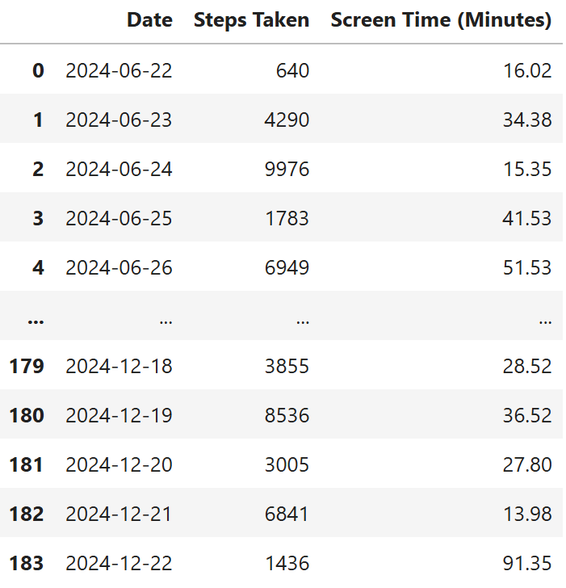
MY DATA SET
The data frame combines two key variables:
Steps Taken
Screen Time (Minutes)
They are aligned by date for future calculations, such as outlier detection, correlation, hypothesis testing, etc. This ensures that each row represents a day with corresponding values for step count and TikTok screen time (in minutes)

Slide 4
MY HYPOTHESIS
As my TikTok screen time increases, my step count decreases.

Slide 5
Health Data

Slide 6
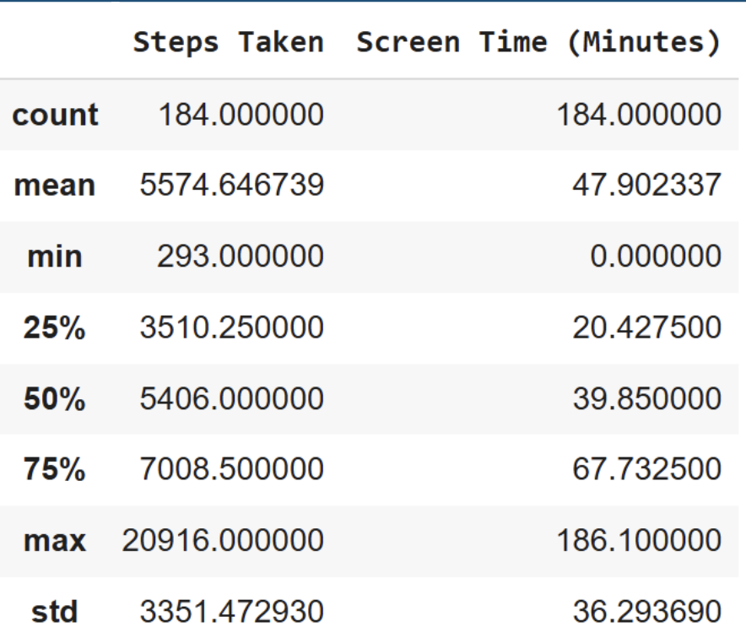
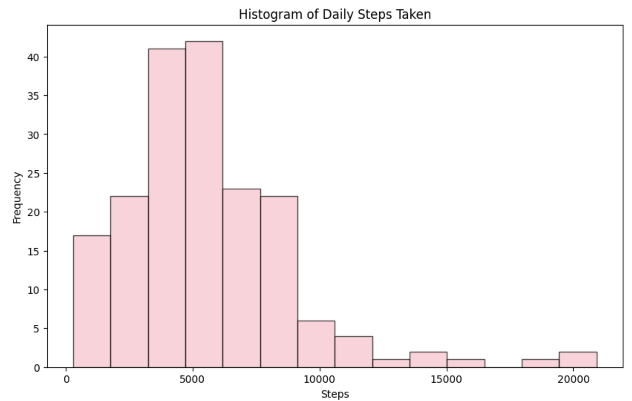
I have started exploring my health data by displaying descriptive statistics and plotting a histogram.

Slide 7
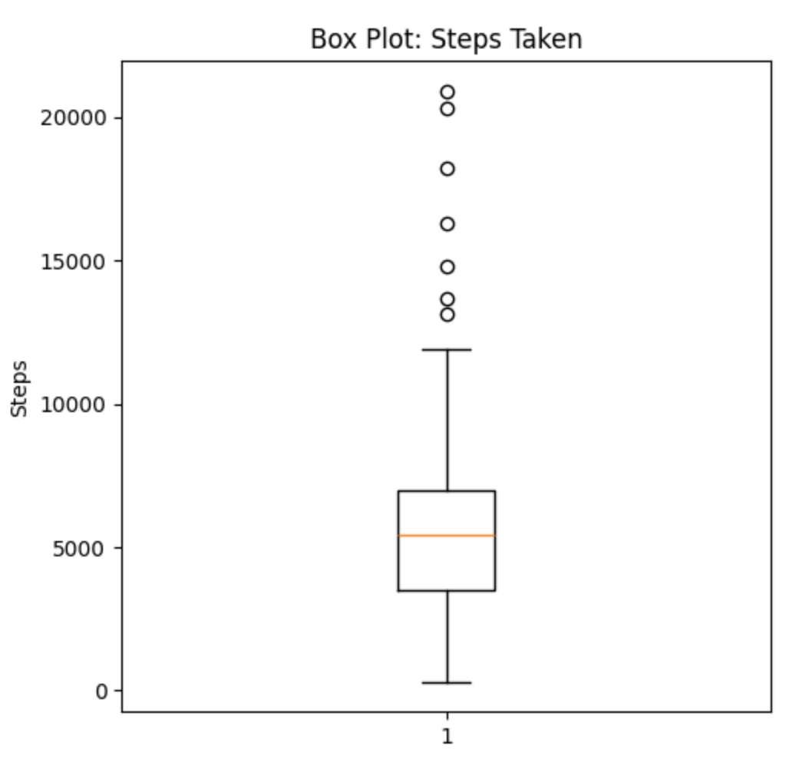
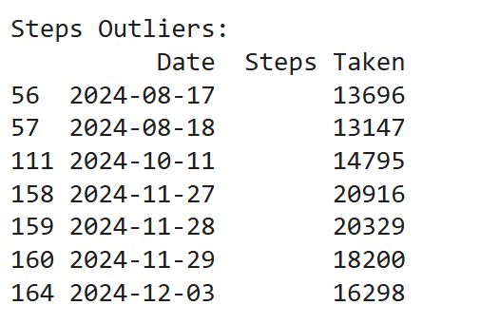
Detecting Outliers
I created box plots to identify outliers. I thought the outliers might represent unusual activities, however, I was not doing anything special on those days, reflecting usual activity for me.

Slide 8
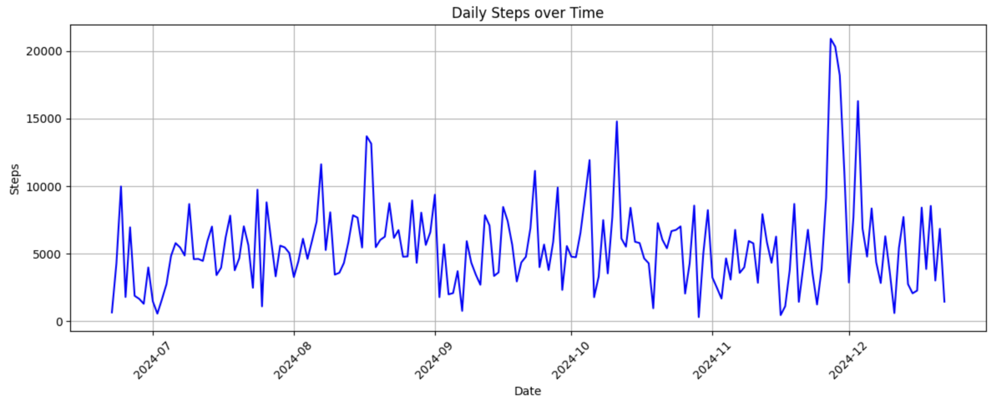
Then I continued with Time Series Analysis of Daily Steps Taken
While there are fluctuations in the data, no clear trend is visible across the timeline.

Slide 9
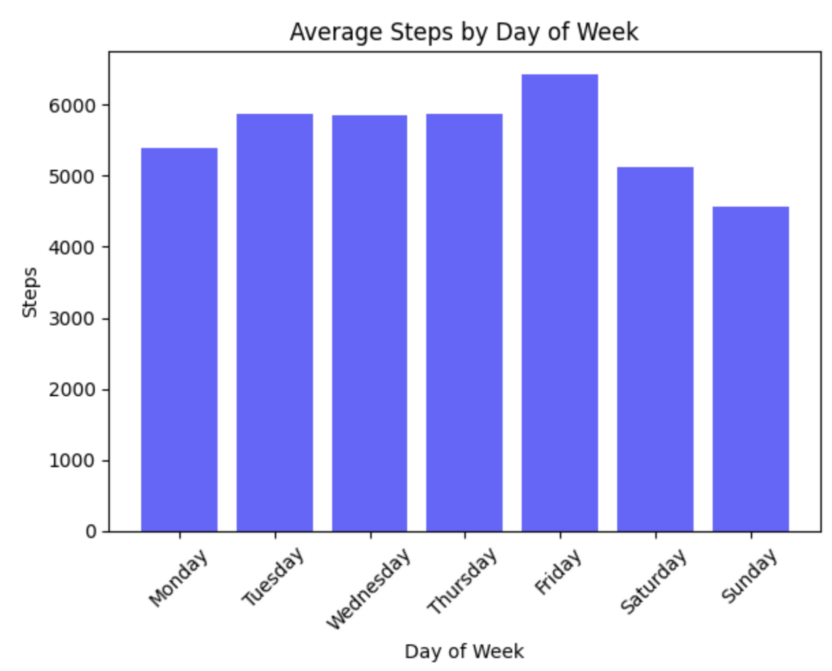
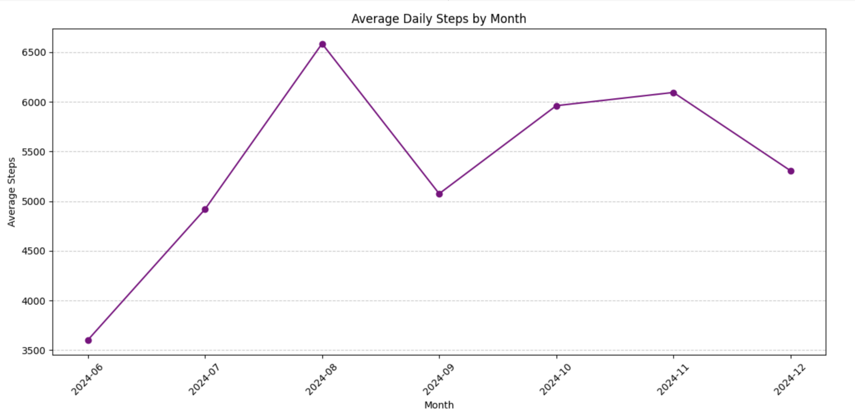
I wanted to see if there are any differences in the weekends and in different months
The results indicate that activity levels are relatively consistent across weekdays, with slightly lower averages on Saturday and Sunday. It suggests that school plays an important role for maintaining physical activity.
A peak in activity is observed in August, possibly due to summer holidays or good weather conditions for outdoor activities. Activity levels tend to decrease starting from September, coinciding with the return to school continue to decline toward December.

Slide 10
TikTok Data

Slide 11
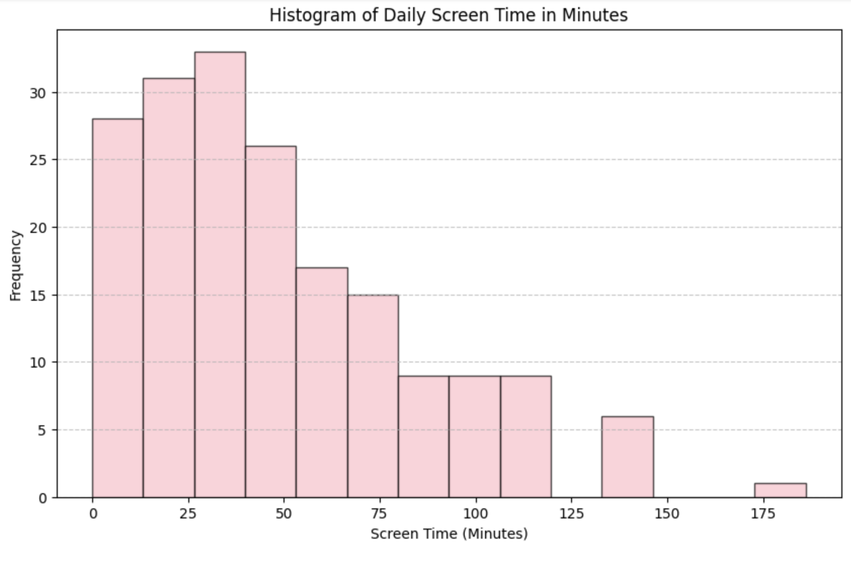
I have started exploring my TikTok data by displaying descriptive statistics and plotting a histogram.

Slide 12
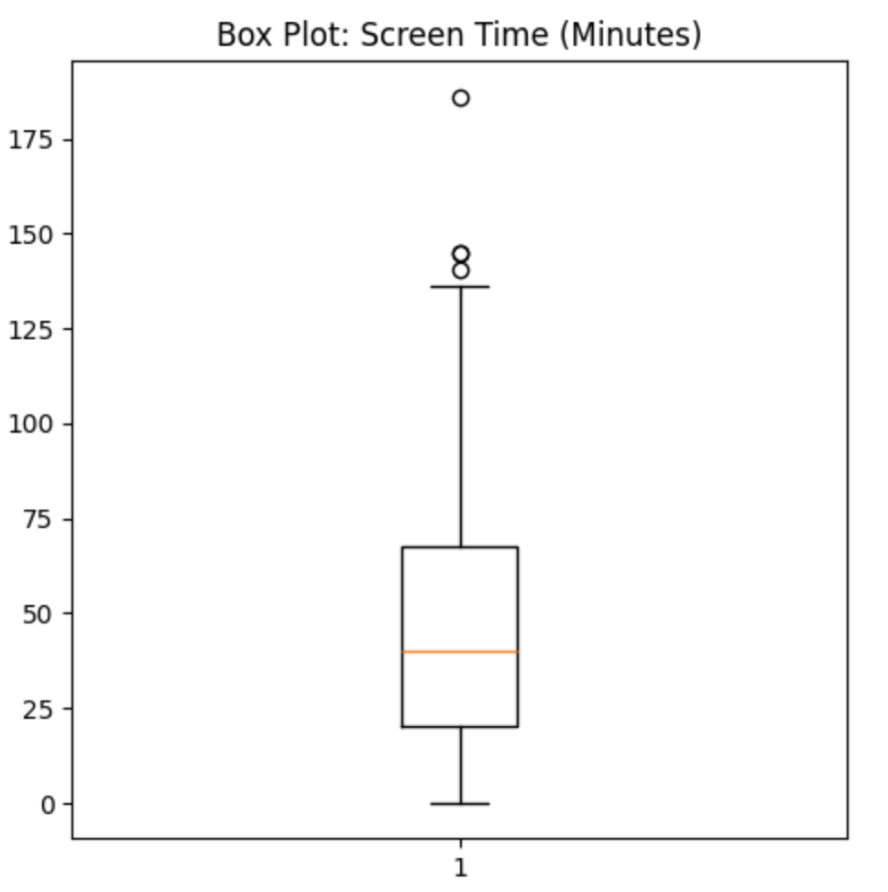
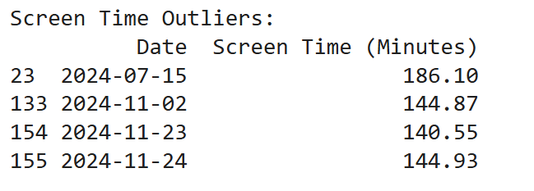
Detecting Outliers
I created box plots to identify outliers. There were not much outliers for daily screen time. I thought the outliers might represent unusual activities, however, I was not doing anything special on those days, reflecting usual activity for me.

Slide 13
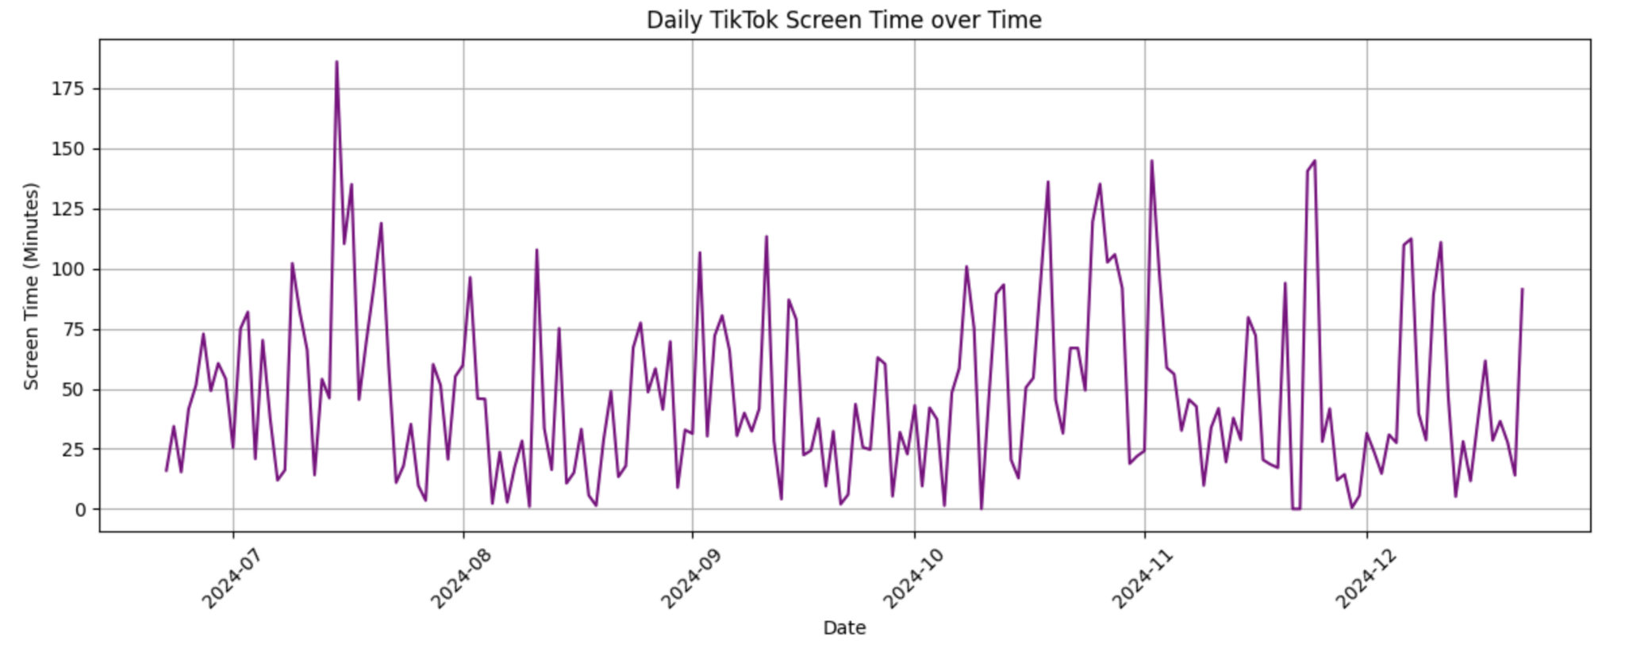
Then I continued with Time Series Analysis Daily TikTok Screen Time
While there are fluctuations in the data, no clear trend is visible across the timeline.

Slide 14
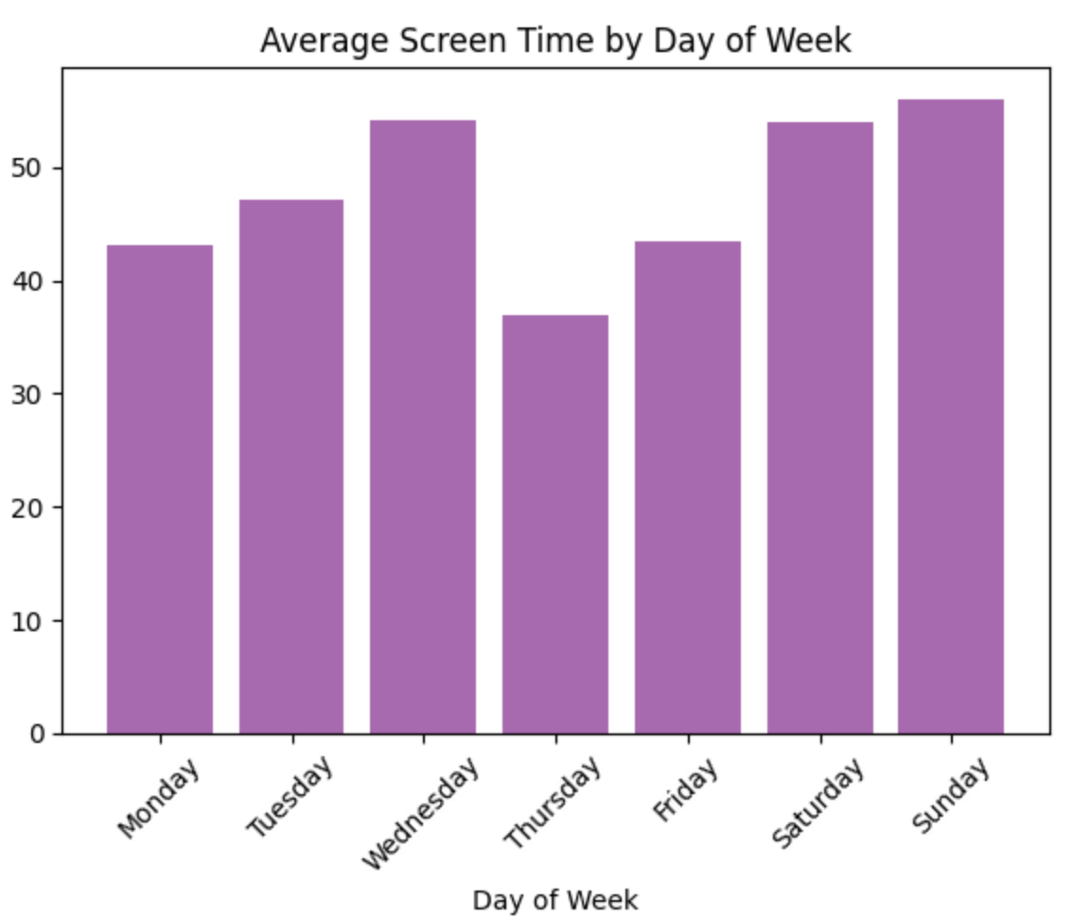
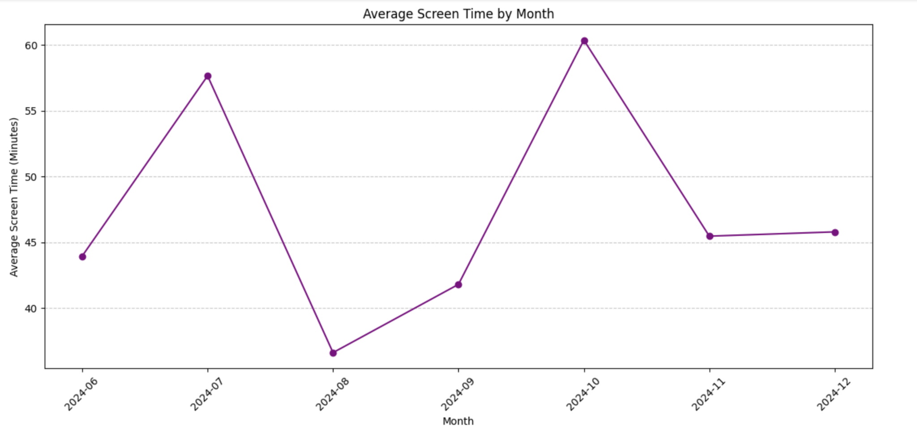
I wanted to see if there are any differences in the weekends and in different months
Saturday and Sunday show slightly higher screen time compared to weekdays. This might reflect more leisure time during the weekends, leading to increased TikTok usage.
Average Screen Time is the lowest in August and the highest in October. It seems to be the same on average in November and December.

Slide 15
FINDINGS

Slide 16
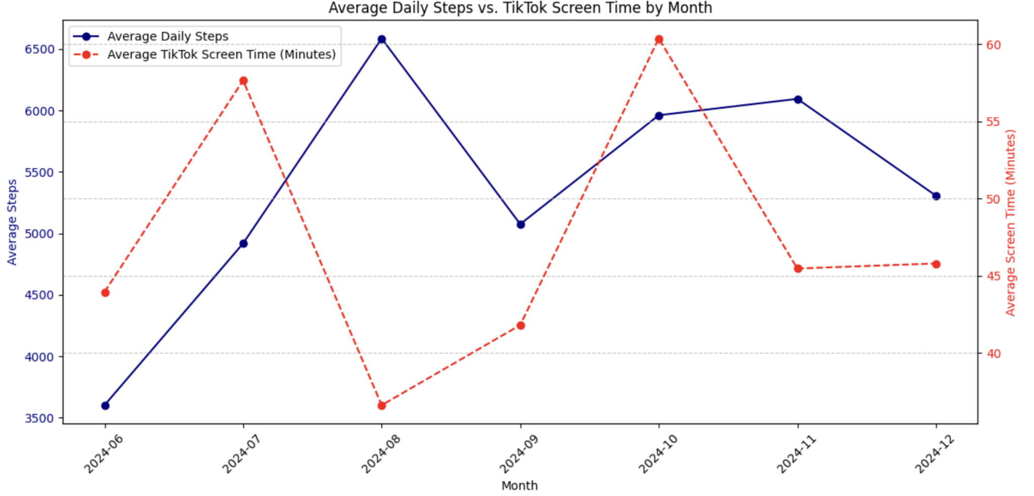
Combining Two Data Sets
The difference between screen time and step count in August supports my hypothesis the most.
Between July and August, as step counts increase, screen time decreases, supporting the hypothesis.
Similarly, from August to September, step counts decrease while screen time increases, further reinforcing the relationship.
Outside of these periods, such as from October onwards, the relationship is less evident. This suggests that other factors might influence the patterns.

Slide 17
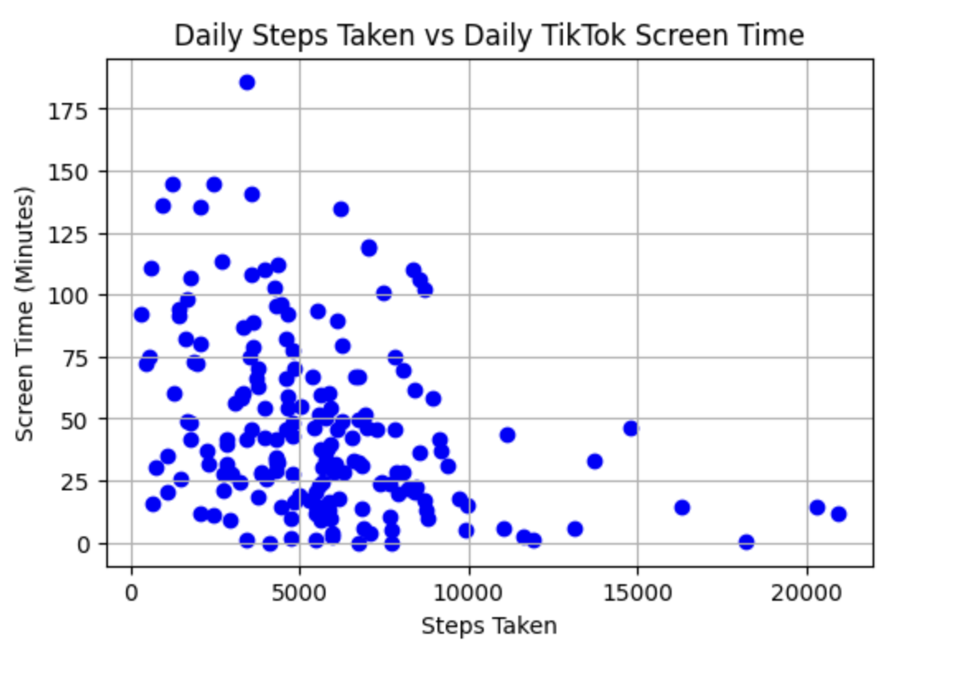
Scatter Plot of Steps Taken vs TikTok Screen Time
By looking at this scatter plot, I can see that there seems to be a negative relationship between the step count and screen time.

Slide 18
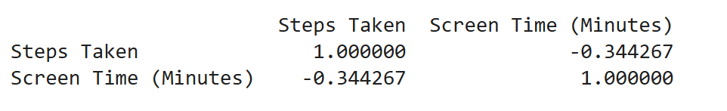
Correlation Coefficient
The correlation coefficient also implies a negative moderate relationship.
I identified days where I had exams and excluded them from the dataset. On exam days, I observed that both my step count and screen time tend to be lower, which could bias the results.
⇒ After removing exam days, the recalculated correlation coefficient is -0.350555, which is slightly more negative than the original value. This slight increase in the strength of the negative correlation implies that exam days introduced a slight noise into the data.

Slide 19
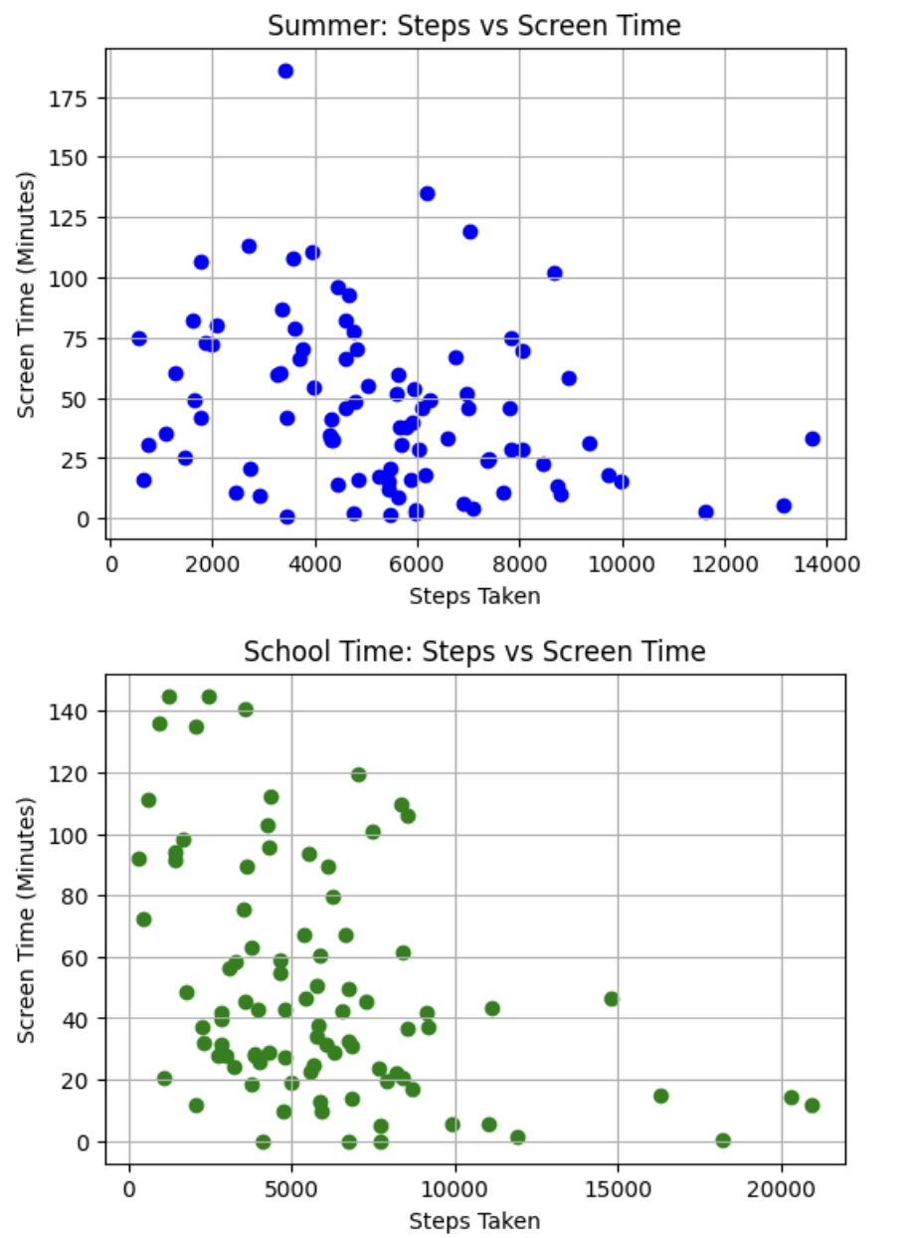
Correlation Coefficient
I also have the data from both the summer holiday and the school time, so I wanted to see if there are any difference between those. By looking at the correlation coefficients, the relationship between step count and screen time seems to be stronger in school time, and weaker in summer holiday.

Slide 20
CONCLUSION

Slide 21
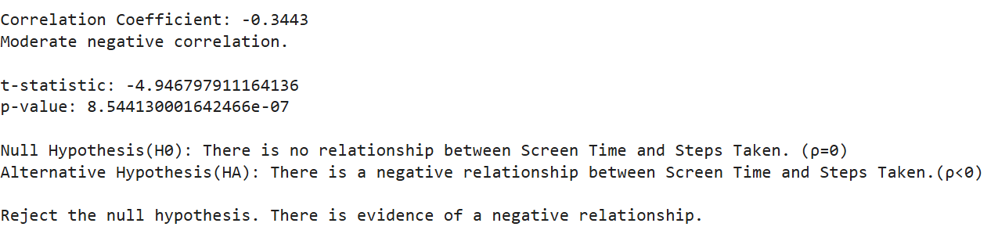
Hypothesis testing
I have formed my null and alternative hypothesis as:
H₀ : There is no negative relationship between TikTok Screen Time and Step Count. (ρ=0)
H_{A} : There is a negative relationship between TikTok Screen Time and Step Count.(ρ<0)
I performed a one-tailed hypothesis test on 0.05 significance level.
The p-value of 8.54×10⁻⁷ is much smaller than the significance level (α=0.05). Thus, I reject the null hypothesis, claiming that there is a negative relationship between TikTok Screen time and Step Count.

Slide 22
p-value (8.54×10⁻⁷ ) resulted from my hypothesis test was smaller than the significance level (0.05), implying that there is a negative relationship between TikTok Screen Time and Step Count, suggesting that my initial hypothesis was correct.

Slide 23
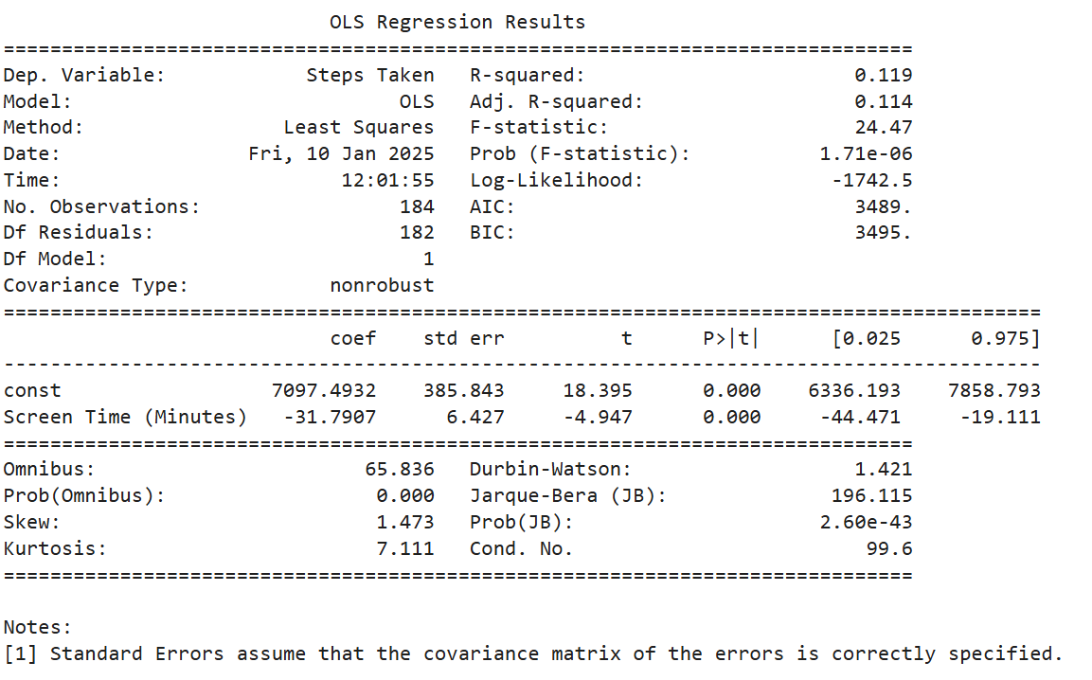
Limitations and Future Work
According to the results of my regression model, R² value of 0.119 indicates that only 11.9% of daily steps taken can be explained by TikTok Screen Time. While there is a statistically significant relationship, screen time is not enough to explain the variation in step Count, and I need to consider other factors such as weather conditions, social activities, physical health, etc.
For future work, I can include other factors (weather conditions, social activities, physical health) and try to explain the variation in my step count by the other factors included in my model.

